Slide 1
Project Setup
Dirk Riehle, Univ. Erlangen
AMOS A02
Licensed under CC BY 4.0 International

Slide 2
Scrum Roles
Product owner
Holds overall responsibility for the product being developed
Provides product vision and product requirements
Plans and helps plan development and tracks progress
Software developer
Holds overall responsibility for design and implementation of product
Estimate complexity (“size”) of product features to be implemented
Organizes and allocates design and implementation tasks
Scrum Master
Holds overall responsibility for following Scrum properly
Is responsible for tracking and resolving impediments
Is responsible for team and process improvement

Slide 3
Tools Overview
The planning document (Google Sheets)
Used by everyone
The feature board (GitHub project)
Used predominantly by the product owner
The code repository (GitHub code)
Use predominantly by the software developer
The impediments backlog (GitHub project)
Used by the Scrum Master

Slide 4
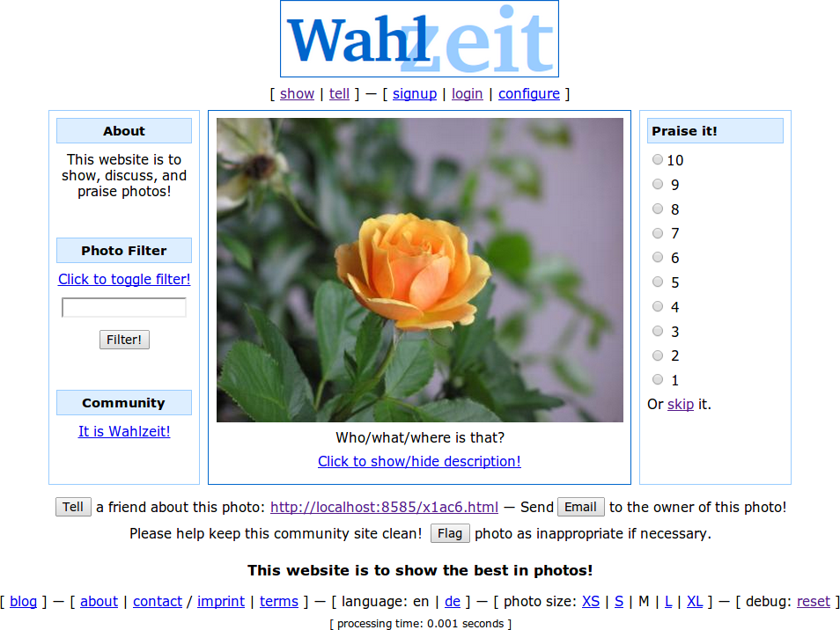
The Flowers Project Example

Slide 5
1. Project Management

Slide 6
There is no Scrum Project Manager
Scrum teams are self-organizing
In (AMOS) practice, product owners also often play project managers

Slide 7
The Planning Document
The planning document serves
To document and coordinate basic structural information
To collect all materials that don’t go easily into the repository
See also the Flowers example planning document

Slide 8
Table of Contents
# | Artifact Name | Artifact Purpose
1 | Project data | Provides basic project data
2 | Project team | Shows project team
3 | Role assignments | Tracks role assignment
4 | Team contract | Shows team contract
5 | Product goal | Provides product vision and project mission
6 | Product glossary | Provides domain terminology of project
7 | Mid-project release tracking | Tracks mid-project release sprints
8 | Final project release tracking | Plans and tracks final project release sprints
9 | Definition of done | Provides decision criteria for “done”
10 | Documentation | Provide links to documentation of product
11 | Bill of materials | Lists all third-party components
12 | Planning poker | Provides simple tool for planning poker

Slide 9
1. Project Data
Please fill in the data as needed and as you see fit
Please do not protect the online team meeting

Slide 10
2. Project Team
Please provide your name and GitHub id
Please use only one GitHub id during the semester

Slide 11
3. Role Assignments
Please fill in the roles people play in a given week (sprint)
We strongly encourage to do this once at the start of the project
The release manager is responsible for ensuring that the software can be demoed

Slide 12
The GitHub Repository
Almost all work takes place in the project’s GitHub repository
Please create and provide your GitHub id as soon as possible

Slide 13
Project Deliverables
Please provide all deliverables (homework) in the
Deliverables folder of the project’s GitHub code repository
Details can be found in the homework instructions

Slide 14
Terms (The GitHub Terminology Mess)
Scrum | AMOS | GitHub | Other
Project | Project | Repository | –
Backlogs [1] | Backlogs | Project [2] | –
Kanban board [3] | Feature board | Project | –
Backlog item [4] | Backlog item | Item, also issue [5] | Work item, ticket
– | Code repository | Code | –
[1] Backlogs can be of different types: Product backlog, sprint backlog
[2] The columns of a GitHub project represent the different backlogs + states of work
[3] Scrum proper does not know kanban boards, but agile in general acknowledges them
[4] Backlog items can be of different types: Feature [6], refactoring, bug fix
[5] Terms vary throughout the GitHub user interface
[6] Features should be presented using the user story format

Slide 15
2. Product Owner / Feature Board

Slide 16
Backlog Items (Also: Issue, Work Item, Ticket)
A backlog item is an
ideally semantically closed
task that needs doing
Types of backlog items
Features (functional and non-functional user requirements)
Refactorings (behavior-preserving code improvements)
Bugs fixes (fixes to malfunctioning code)
We use GitHub issues to represent backlog items
Either by directly entering them into the GitHub project (the feature board)
Or by entering them as an issue, also assigning them to the feature board

Slide 17
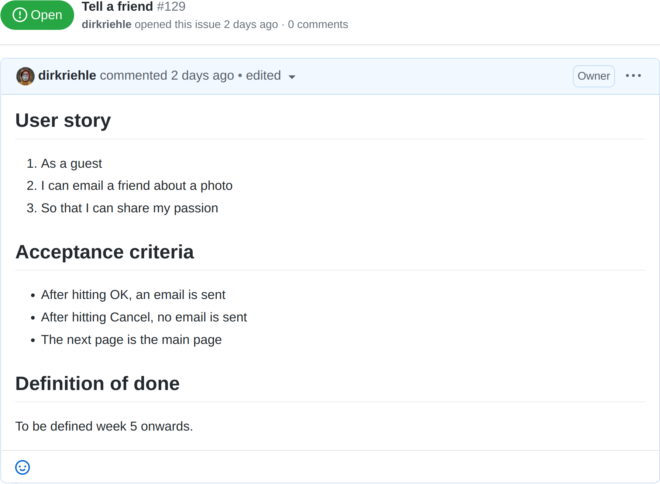
Example Issue Using User Story Format

Slide 18
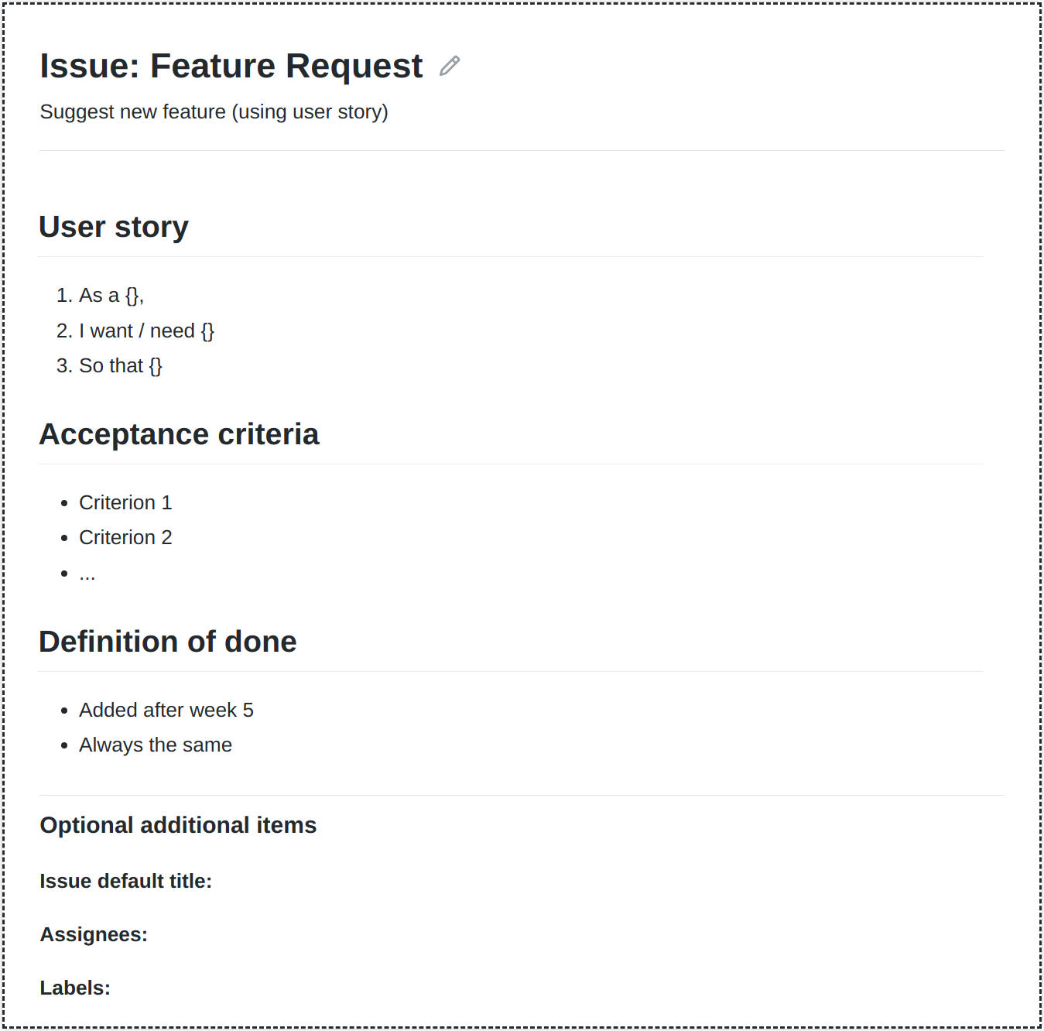
Issue Templates
Please create a template for feature requests
The template should contain fields for
Short name (already preset as title field)
Short description (using user story)
Acceptance criteria (to test for fulfillment)
Definition of done (from week 5 on)
Create labels for features sizes
Est. size = X for estimated sizes
Set during sprint planning
Real size = Y for actual size
Set during sprint review
Use escalating colors
Feel free to add other templates

Slide 19
Feature Board (GitHub Project)
A feature board is a slotting system used to
Manage the processing state of backlog items
Types of slots (work process states, represented by columns)
Product backlog (needs doing)
Sprint backlog (ready to be done)
In progress (being worked on)
Awaiting review (needs sign-off)
Feature archive (finished and archived)
Please do not change the feature board’s setup

Slide 20
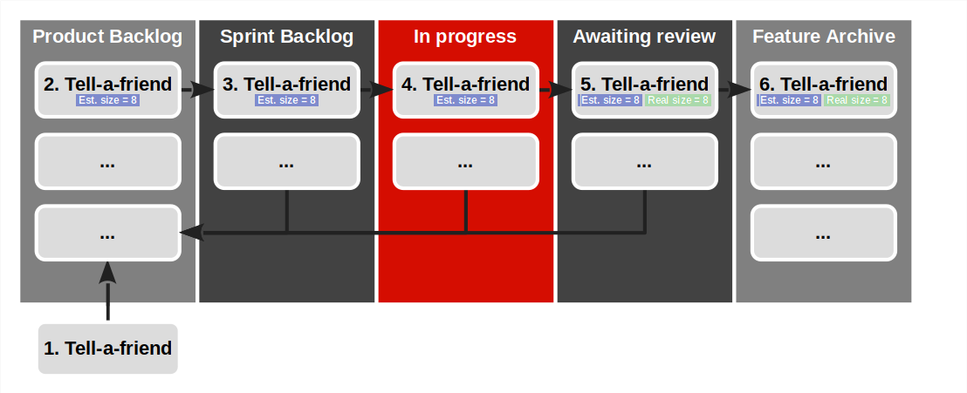
Example Feature Board and Backlog Items

Slide 21
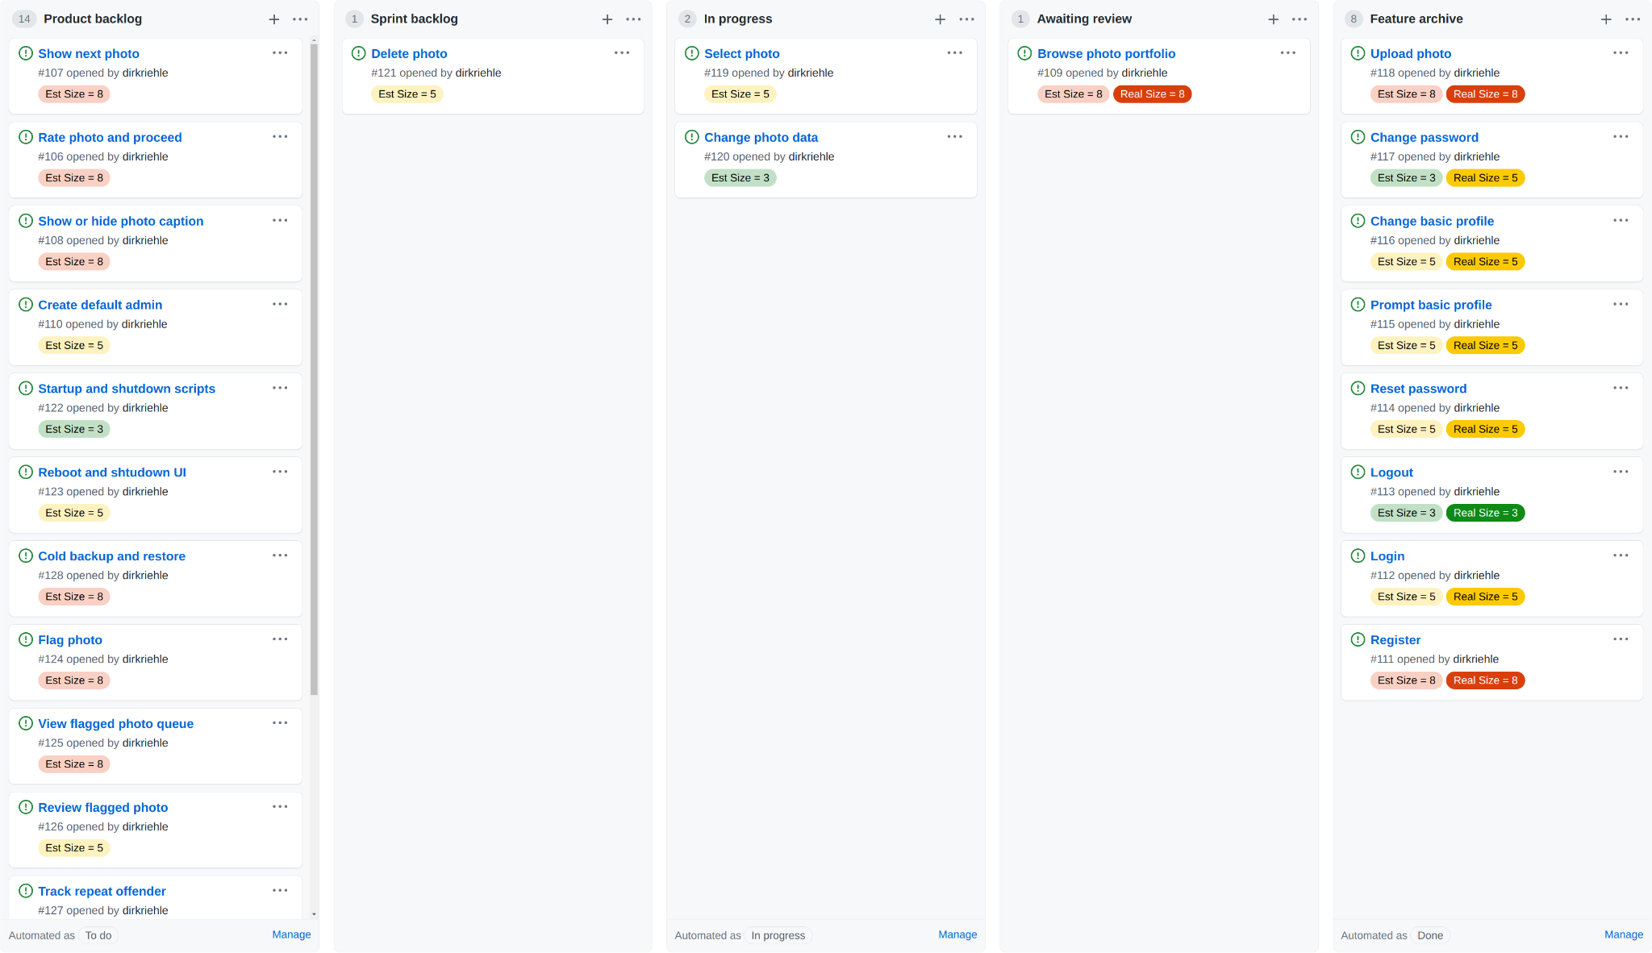

Slide 22
2. Software Developer / Code Repository

Slide 23
Git User Setup
Please use only one account and one email address and stick to it
Please configure your name and email address for your local repository
Please make sure this is the same information as on github.com
dirk@host$ git config -local user.name "Dirk Riehle"
dirk@host$ git config -local user.email "dirk@riehle.org"

Slide 24
Git Commit Sign-off
Please sign-off on your commits as your work using –signoff
This will add your name and email address to the commit message
dirk@host$ git commit -m "Fixed issue #123" --signoff

Slide 25
Pair Programming
If you are pair programming, make sure you document this in your commits
Add “Co-authored-by:” to commit message and using the correct email address
Double-check the syntax (otherwise co-authorship will not be recognized)
(Each co-authored-by needs to be on its own line.)
Please find more information on GitHub
dirk@host$ git commit -a -m "Fixed problem
> Co-authored-by: Stefan Buchner <stefan.buchner@fau.de>
> Co-authored-by: Dirk Riehle <dirk@riehle.org>"

Slide 26
The AMOS Project Licenses
For source code, we use the MIT license
See https://opensource.org/licenses/MIT
For other data, we use the CC BY 4.0 license
See https://creativecommons.org/licenses/by/4.0/

Slide 27
License and Copyright Declaration in Files
Please use the REUSE SOFTWARE [1] format to declare license and copyright
// SPDX-License-Identifier: MIT
// SPDX-FileCopyrightText: 2010-2021 Dirk Riehle <dirk@riehle.org>
// SPDX-FileCopyrightText: 2019 Georg Schwarz <georg.schwarz@fau.de>
[1] See https://reuse.software/

Slide 28
Open Source Governance
Do not add copyleft-licensed libraries to your project
May make later desired license change difficult, including proprietary use
Check with teaching team whether library is OK
Follow these rules of thumb on license choice
OK: Permissive licenses (MIT, BSD, Apache)
May be OK: Weakly protective (a.k.a. “weak copyleft”)
Usually not OK: Strongly protective (a.k.a. “reciprocal” or “copyleft”)
Never OK: Non-software licenses, no license
Professionals (i.e. companies) use code scanners to check

Slide 29
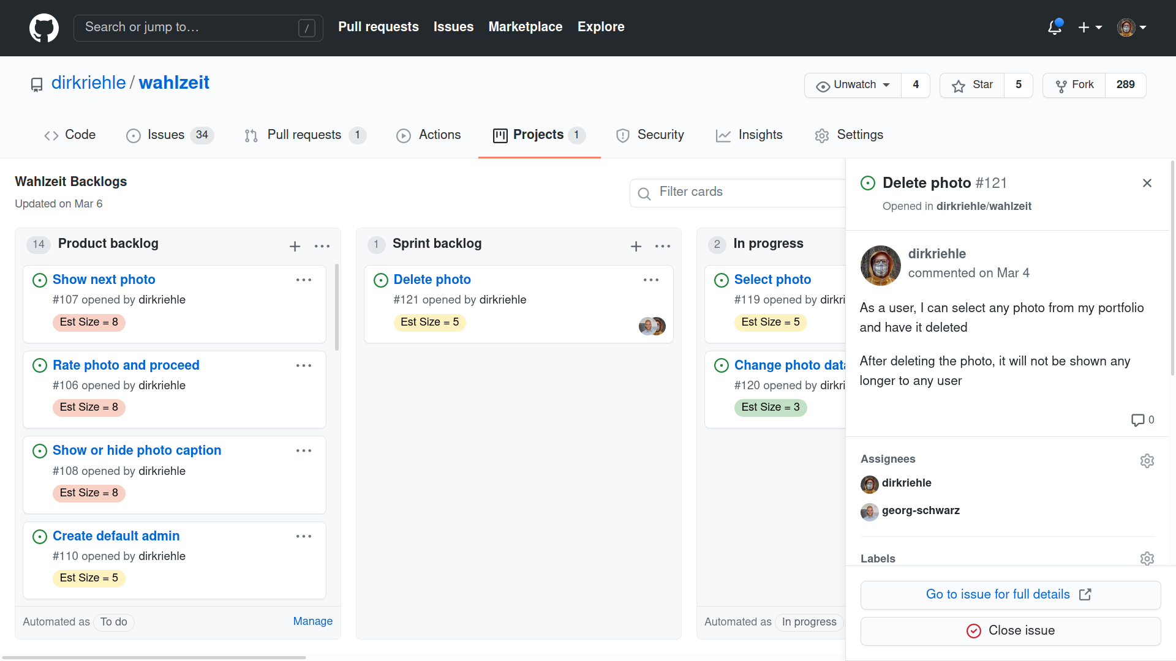

Slide 30
4. Scrum Master / Impediments Backlog

Slide 31
Impediments Backlog (GitHub Project)
The impediment backlog is a slotting system used to
Manage the processing state of project impediments
Impediments are non-technical problems that are
Holding the team and project back

Slide 32
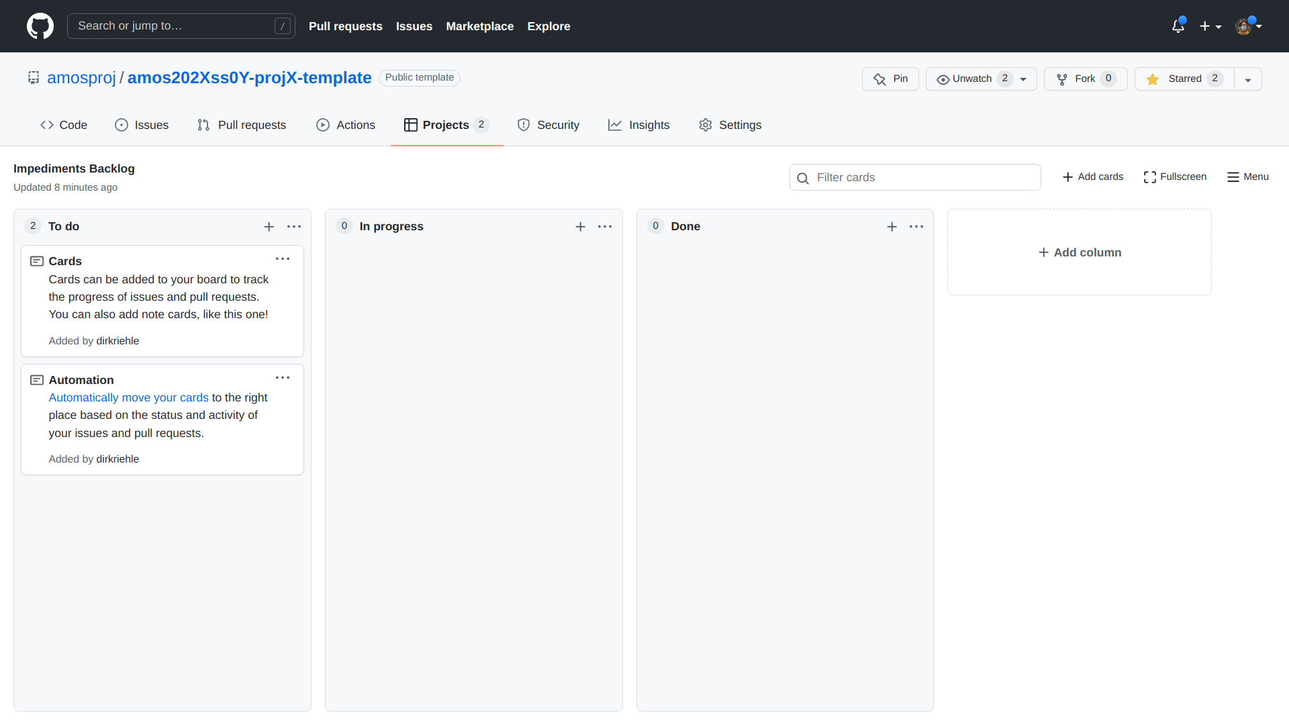

Slide 33
Thank you! Any questions?
dirk.riehle@fau.de – https://oss.cs.fau.de
dirk@riehle.org – https://dirkriehle.com – @dirkriehle

Slide 34
Legal Notices
License
Licensed under the CC BY 4.0 International license
Copyright
© Copyright 2023 Dirk Riehle, some rights reserved

